Slide 1
Decoding Dementia
David Fox, M.D.
Medical Director
Behavioral Center For Older Adults
UH Parma Medical Center

Slide 2
Dementia vs. Alzheimer’s Disease
Case Study: Marilyn
68 year-old woman presents with complaint: “I can’t remember things”.
12 month history of forgetfulness, first noted by husband as “extraordinary repetitiveness”.
Some difficulty with balancing her checkbook
Excellent physical health
Mother had dementia in her late 80’s.
Brain CT normal
MMSE 27/30 but missed 2 of 3 questions of recent recall
Failed clock drawing test

Slide 3
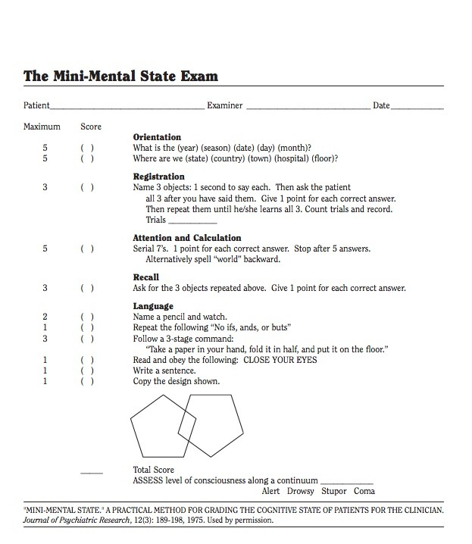

Slide 4
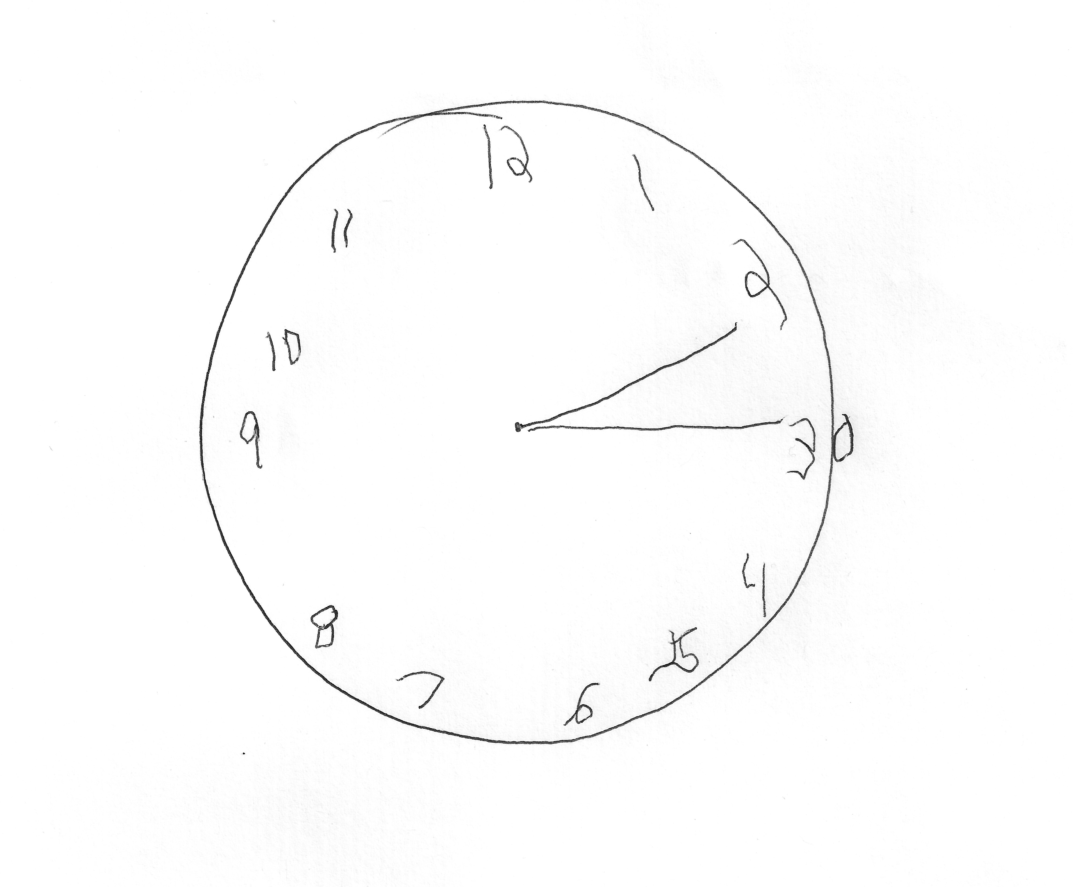
Clock Drawing Test
1. Specificity of clock test. 2. Diagnosis?

Slide 5
Facial Tissue

Slide 6
Fronto-Temporal
(Picks Disease)
Creutzfeldt-Jakob
Disease
Huntington’s Disease
Dementia with Lewy Bodies
Down’s Syndrome
TBI

Slide 7
Prevalence of Alzheimer’s Disease
An estimated 5.2 million Americans of all ages have Alzheimer’s disease in 2013. This includes an estimated 5 million people age 65 and older and approximately 200,000 individuals under age 65 who have younger-onset Alzheimer’s.
One in nine people age 65 and older (11 percent) has Alzheimer’s disease.
About one in five (18%) of people age 75-84 have AD.
About one-third of people age 85 and older (32 percent) have Alzheimer’s disease.
Of those with Alzheimer’s disease, an estimated 4 percent are under age 65, 13 percent are 65 to 74, 44 percent are 75 to 84, and 38 percent are 85 or older.

Slide 8
Risk Factors For Dementia
Age
Family History
Genetics: APOE-e4 associated with 25% of AD cases.
History of Head Trauma

Slide 9
Hallmark changes of Alzheimer's
Scientists have identified several hallmark Alzheimer's brain abnormalities, including:
Plaques, microscopic clumps of a protein called beta-amyloid peptide
Tangles, twisted microscopic strands of the protein tau (rhymes with "wow")
Loss of connections among brain cells responsible for memory, learning and communication. These connections, or synapses, transmit information from cell to cell.
Inflammation resulting from the brain's effort to fend off the lethal effects of the other changes under way
Eventual death of brain cells and severe tissue shrinkage
All these processes have a devastating impact on the brain, and over time, the brain shrinks dramatically, affecting nearly all its functions.

Slide 10
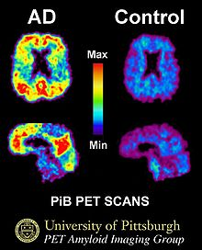
PET Scan Images with Pittsburgh Compound B

Slide 11
STAGES OF DEMENTIA
Stage 1: No impairment (normal function)
The person does not experience any memory problems. An interview with a medical professional does not show any evidence of symptoms of dementia.

Slide 12
Stage 2: Very mild cognitive decline
(may be normal age-related changes or earliest signs of Alzheimer's disease)
The person may feel as if he or she is having memory lapses — forgetting familiar words or the location of everyday objects. But no symptoms of dementia can be detected during a medical examination or by friends, family or co-workers.

Slide 13
Typical age-related memory loss and other changes compared to Alzheimer's
Signs of Alzheimer’s Typical age-related changes
Poor judgment and decision making Making a bad decision occasionally
Inability to manage a budget Missing a monthly payment
Losing track of the date Forgetting which day it is but recall later
Difficulty having a conversation Sometimes forgetting which word to use
Misplacing things and being Losing things from time to time unable to retrace steps to find them

Slide 14
Stage 3
Mild cognitive decline (early-stage Alzheimer's can be diagnosed in some, but not all, individuals with these symptoms)
Friends, family or co-workers begin to notice difficulties. During a detailed medical interview, doctors may be able to detect problems in memory or concentration. Common stage 3 difficulties include: Noticeable problems coming up with the right word or name
Trouble remembering names when introduced to new people
Having noticeably greater difficulty performing tasks in social or work settings. Forgetting material that one has just read
Losing or misplacing a valuable object
Increasing trouble with planning or organizing

Slide 15
Stage 4:
Moderate cognitive decline
(Mild or early-stage Alzheimer's disease)
At this point, a careful medical interview should be able to detect clear-cut symptoms in several areas: Forgetfulness of recent events
Impaired ability to perform challenging mental arithmetic — for example, counting backward from 100 by 7s
Greater difficulty performing complex tasks, such as planning dinner for guests, paying bills or managing finances
Forgetfulness about one's own personal history
Becoming moody or withdrawn, especially in socially or mentally challenging situations

Slide 16
Stage 5: Moderately severe cognitive decline
(Moderate or mid-stage Alzheimer's disease)
Gaps in memory and thinking are noticeable, and individuals begin to need help with day-to-day activities. At this stage, those with Alzheimer's may: Be unable to recall their own address or telephone number or the high school or college from which they graduated
Become confused about where they are or what day it is
Have trouble with less challenging mental arithmetic; such as counting backward from 40 by subtracting 4s or from 20 by 2s
Need help choosing proper clothing for the season or the occasion
Still remember significant details about themselves and their family
Still require no assistance with eating or using the toilet

Slide 17
Stage 6: Severe cognitive decline
(Moderately severe or mid-stage Alzheimer's disease)
Memory continues to worsen, personality changes may take place and individuals need extensive help with daily activities. At this stage, individuals may: Lose awareness of recent experiences as well as of their surroundings
Remember their own name but have difficulty with their personal history
Distinguish familiar and unfamiliar faces but have trouble remembering the name of a spouse or caregiver
Need help dressing properly and may, without supervision, make mistakes such as putting pajamas over daytime clothes or shoes on the wrong feet
Experience major changes in sleep patterns — sleeping during the day and becoming restless at night
Need help handling details of toileting (for example, flushing the toilet, wiping or disposing of tissue properly)
Have increasingly frequent trouble controlling their bladder or bowels
Experience major personality and behavioral changes, including suspiciousness and delusions (such as believing that their caregiver is an imposter) or compulsive, repetitive behavior like hand-wringing or tissue shredding
Tend to wander or become lost

Slide 18
Stage 7: Very severe cognitive decline
(Severe or late-stage Alzheimer's disease)
In the final stage of this disease, individuals lose the ability to respond to their environment, to carry on a conversation and, eventually, to control movement. They may still say words or phrases.
At this stage, individuals need help with much of their daily personal care, including eating or using the toilet. They may also lose the ability to smile, to sit without support and to hold their heads up. Reflexes become abnormal. Muscles grow rigid. Swallowing impaired.

Slide 19
Marilyn’s History Overview
Onset of memory symptoms age 67-68, diagnosis made.
Age 73, more severe short term memory loss but still driving and water skiing.
Age 76, husband notes worsening of long term memory. Stayed alone in house when husband hospitalized for 5 days. Remains active in yard.
Age 77, stopped driving.
Age 78, no longer left alone at home, caregiver helping with showering, husband doesn’t look like “the same man I married.” Difficulty following directions (how to turn on ceiling fan, stopped doing yard work. Apathetic.
Age 80, language dysfunction, wandering
Age 81, difficulty walking, had to be fed.
Age 82, dies from Breast cancer.

Slide 20
Behavioral Problems Associated with Later Stages of Dementia
Anger, irritability
Agitation (Do not use this word, describe it!)
1. Physical Aggression
2. Resisting Care
3. Verbal outbursts
4. Motor restlessness, pacing
Hallucinations (seeing, hearing or feeling things that are not really there)
Delusions (firmly held belief in things that are not true)
Sleep disturbances
Sundowning

Slide 21
Treatments
Aricept (Donepezil)
Exelon (Rivistigmine)
Razadyne (Galantamine)
Namenda (Mementine)
Medications slow progression of illness but do not cure it or stop progression.

Slide 22
New Research
Targets for future drugs:
Beta-amyloid is the chief component of plaques, one hallmark Alzheimer's brain abnormality. Scientists now have a detailed understanding of how this protein fragment is clipped from its parent compound amyloid precursor protein (APP) by two enzymes — beta-secretase and gamma-secretase. Researchers are developing medications aimed at virtually every point in amyloid processing. This includes blocking activity of both enzymes; preventing the beta-amyloid fragments from clumping into plaques; and even using antibodies against beta-amyloid to clear it from the brain.
Inflammation is another key Alzheimer's brain abnormality. Scientists have learned a great deal about molecules involved in the body's overall inflammatory response and are working to better understand specific aspects of inflammation most active in the brain. These insights may point to novel anti-inflammatory treatments for Alzheimer's disease.
Insulin resistance and the way brain cells process insulin may be linked to Alzheimer's disease. Researchers are exploring the role of insulin in the brain and closely related questions of how brain cells use sugar and produce energy. These investigations may reveal strategies to support cell function and stave off Alzheimer-related changes.

Slide 23
Prevention
Heart to Head Connection
Physical Activity and Diet
Social Connection and Intellectual Activity

